Slide 1
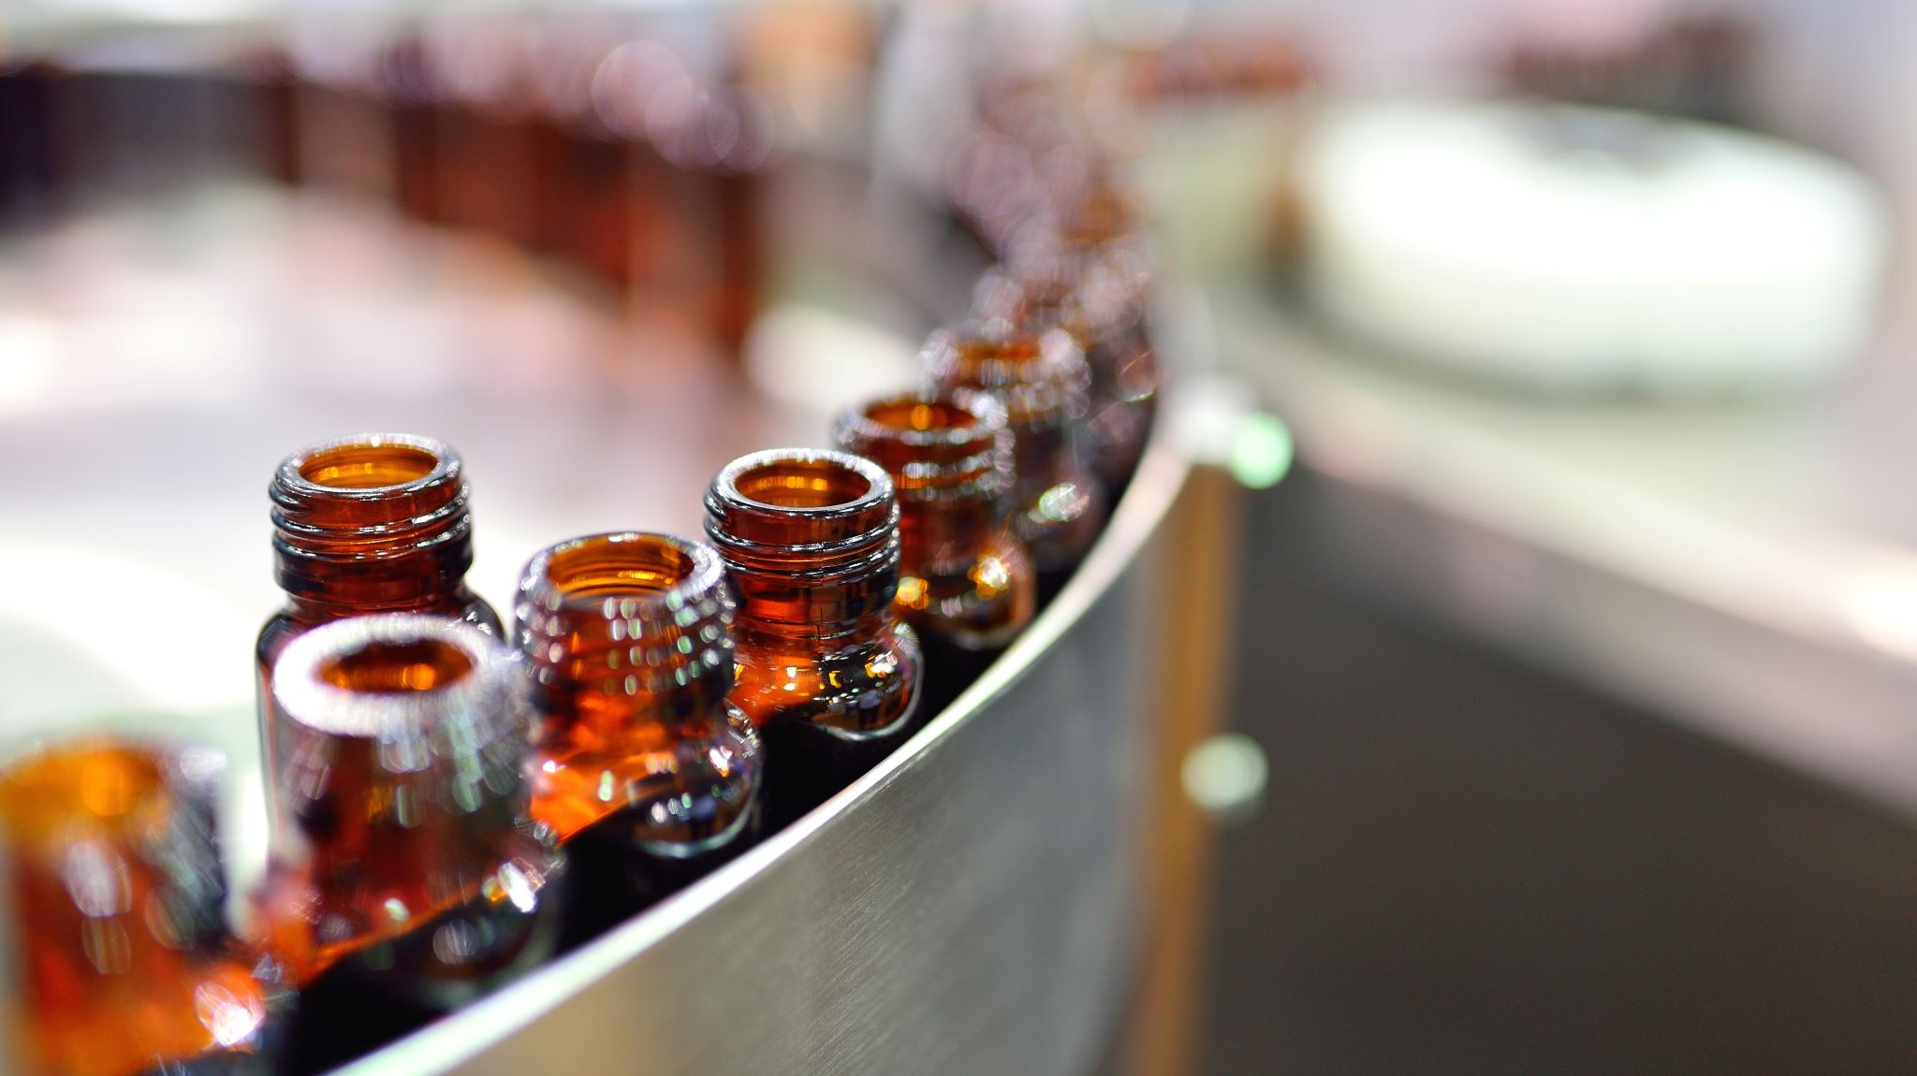
Welcome to Alcoholic Drink Generator!!!!
By: Miles Magee

Slide 2
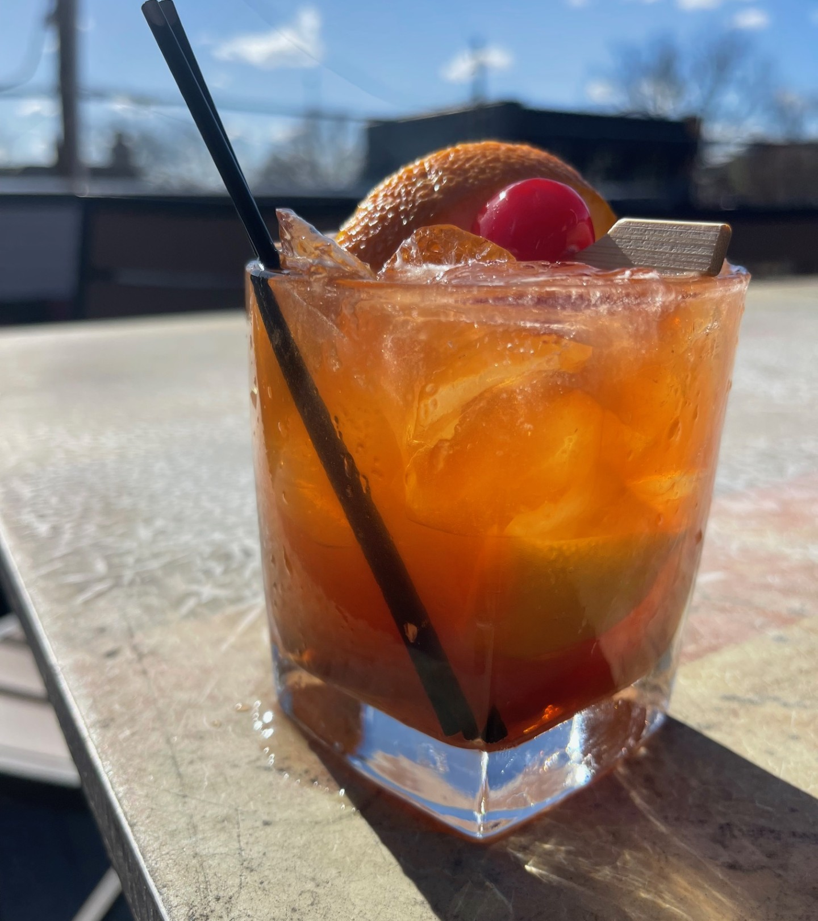
Purpose
- The Alcoholic Drink Generator is designed to take the users input list of available ingredients and generate cocktails based on the ingredients provided. Once the user has entered the ingredients available to them, they will be prompted to type “Exit” to stop the input and allow Alcoholic Drink Generator to process the data and provide results based on the users input. The generator will primarily output a list of cocktails that the user can make based on inputs, and it has a secondary function to display the cocktails that the user is almost able to make. Finaly, the generator will provide the user a shopping list of missing ingredients and will make recommendations of what products to buy in an ordered list. This simple program is designed for users of the age of twenty-one or older, and aids in guiding users that might not be too knowledgeable on alcohol to be able to make drinks at home. It also can serve as a useful tool for bartenders like myself, to connect and expand knowledge to guest.

Slide 3
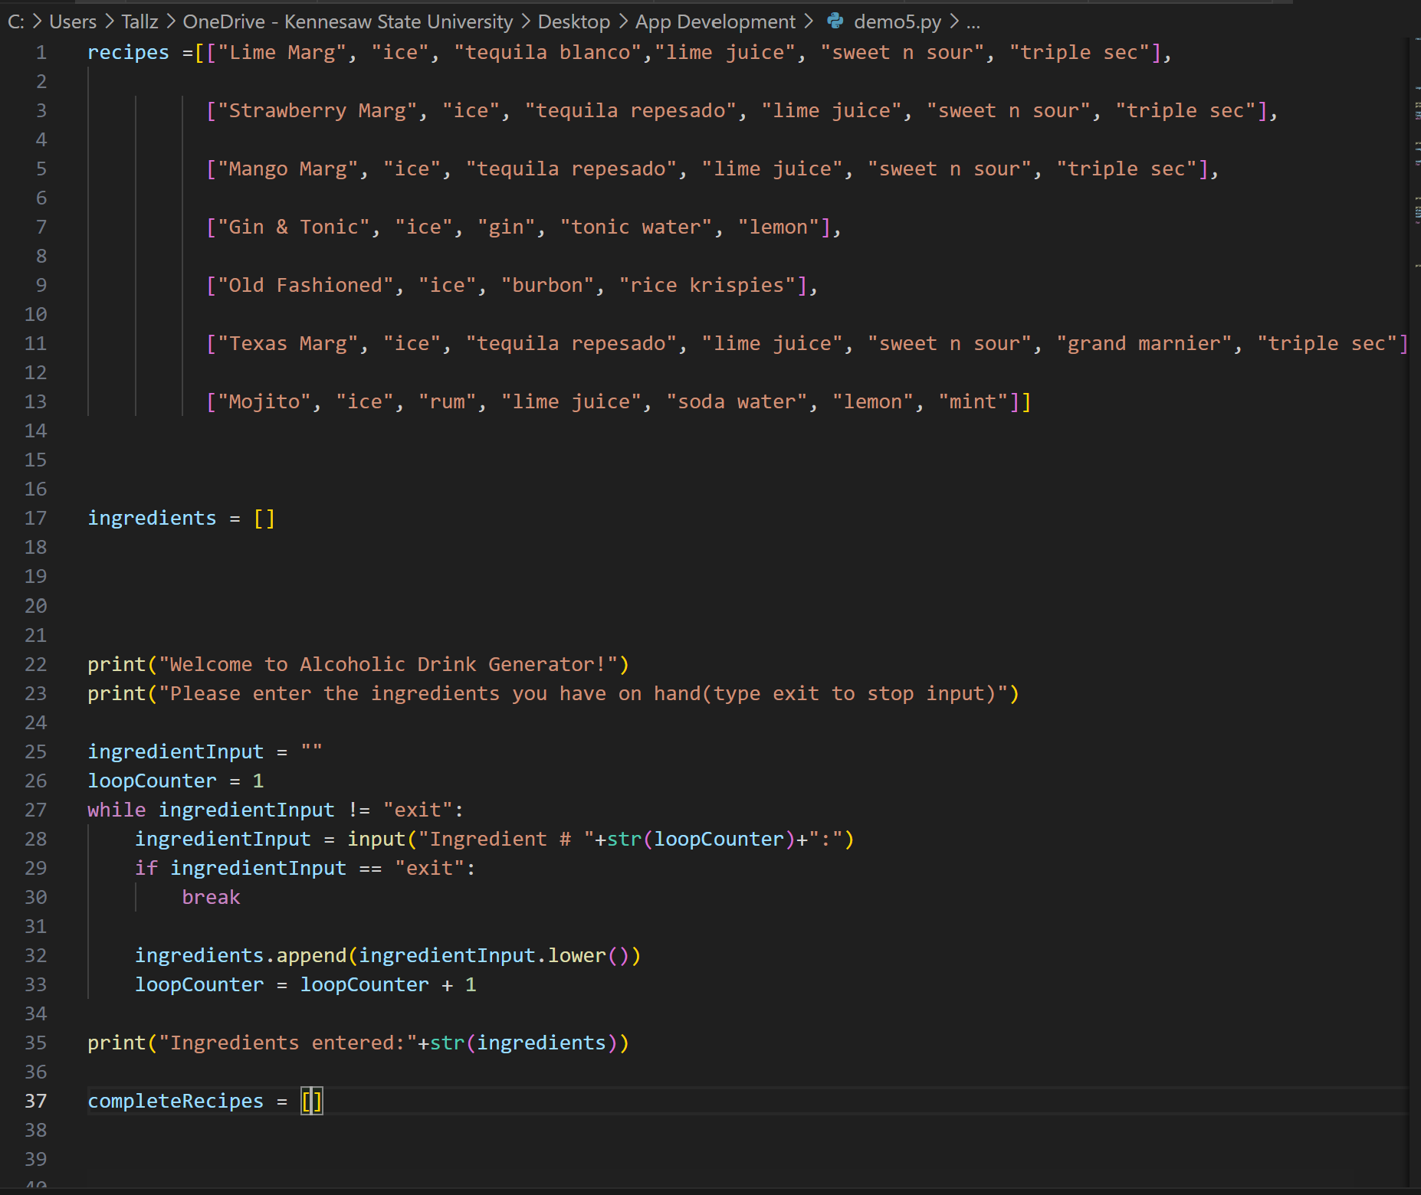
Ingredient code list

Slide 4

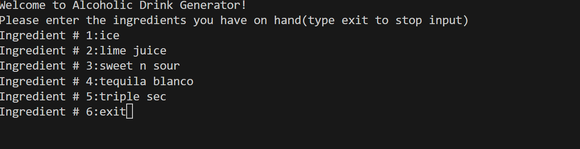
User Input Example (Lime Marg)

Slide 5
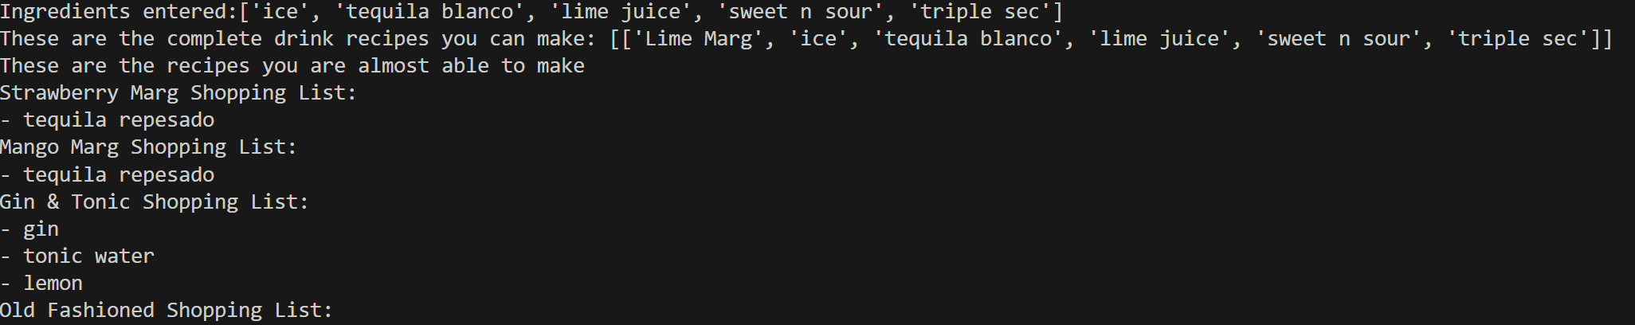
User OUTPUT Example (Lime Marg)

Slide 6
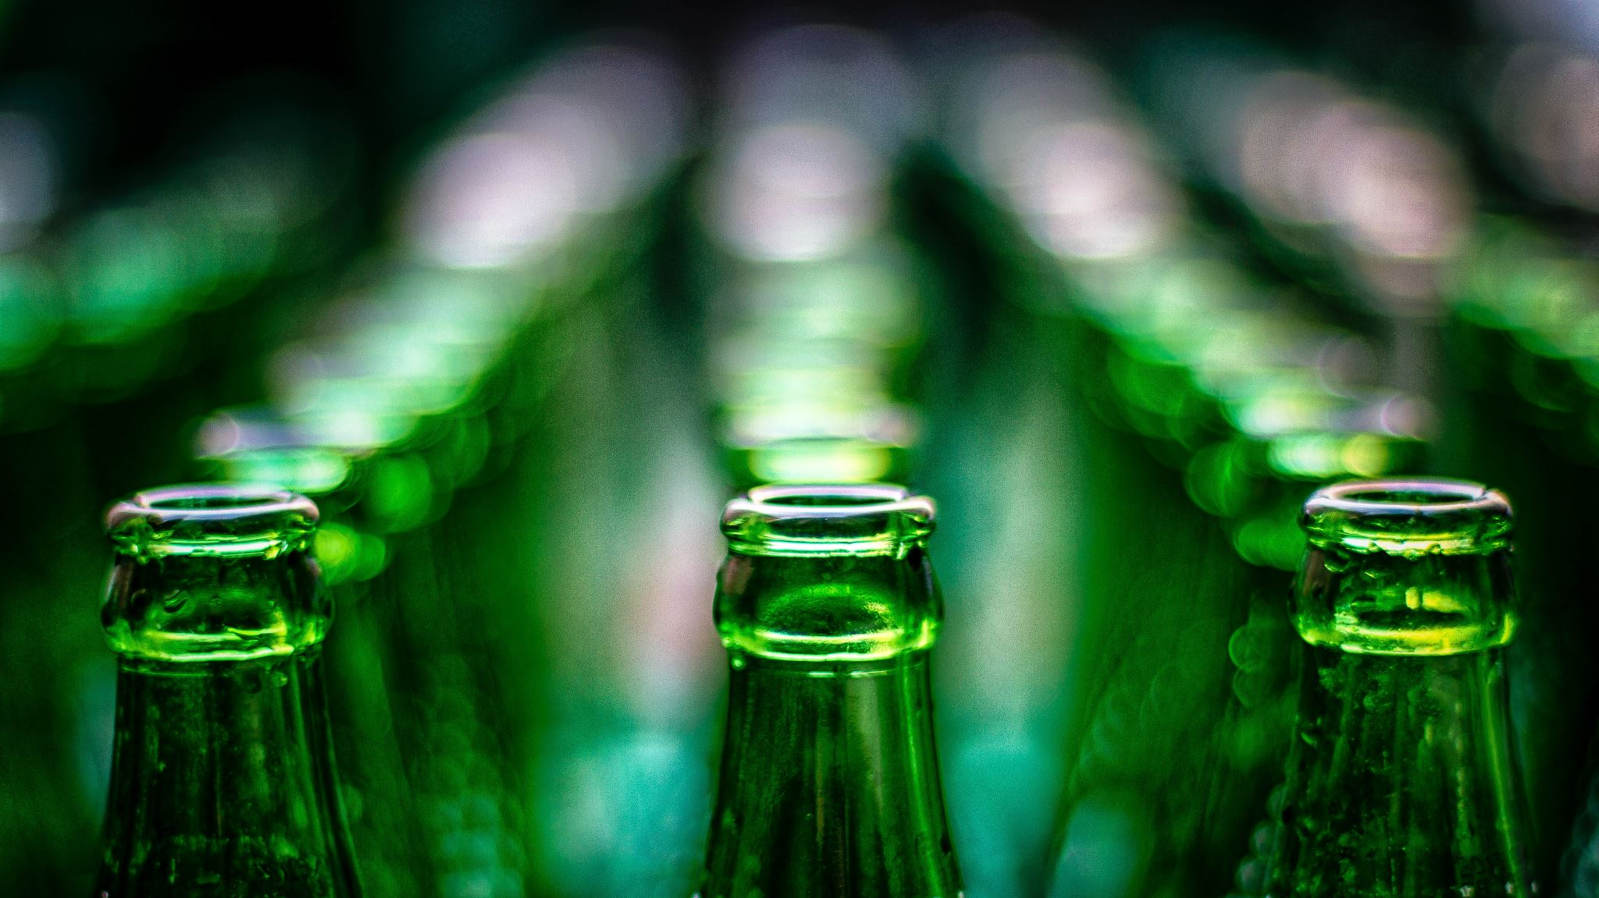
Thanks For Using Alcoholic Drink Generator!!!!!!

